Slide 1


MUSCULOSKELETAL ABNORMALITY DETECTION
Capstone Project Phase 1
2 Credits

Slide 2
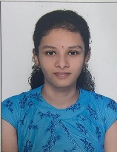
Team Composition
 | PES1UG19EC | ​ ​
​ | PES1UG19EC | ​
KOTHURU EESHA SOUGANDHEEKA | PES1UG19EC​141 | ​ ​ ​
PALADI NAVYA SREE | PES1UG19EC​192 ​ | ​ ​ ​
Guide : Prof. H.R. Vanamala

Slide 3
Contents
Introduction
Problem Statement
Methodology /Motivation
Block Diagram
Working Principle
Deliverables
Literature Survey
Project timeline Gantt Chart

Slide 4
Introduction
Musculoskeletal conditions, a general term used to describe a group of conditions that affects joints, bones, muscles, and the spine.
Musculoskeletal Disorders (MSDs) are excoriations and afflictions that assail body movement of human

Slide 5
Problem Statement
To design a model using deep learning and image processing for the detection of Musculoskeletal disorders.

Slide 6
Methodology Adopted

Slide 7
Motivation
Global Burden of Disease (GBD) conducted a study in 2016, found that musculoskeletal abnormalities were the second highest exploiter to global disability, and lower back pain. Around 20%-30% people worldwide live with tormenting musculoskeletal abnormalities .Sometimes doctors or radiologist can make an error that can mislead the diagnosis of abnormalities.

Slide 8
Block diagram

Slide 9
Brief Working Principle

Slide 10
Deliverables
Design details
Performance improvement graphs / statistics
Validation Report (with benchmark application specified)

Slide 11
References & Literature Survey
[1] A. F. M. Saif, C. Shahnaz, W. Zhu and M. O. Ahmad, "Abnormality Detection in Musculoskeletal Radiographs Using Capsule Network," in IEEE Access, vol. 7, pp. 81494-81503, 2019, doi: 10.1109/ACCESS.2019.2923008.
[2] I. Irmakci, S. M. Anwar, D. A. Torigian and U. Bagci, "Deep Learning for Musculoskeletal Image Analysis," 2019 53rd Asilomar Conference on Signals, Systems, and Computers, 2019, pp. 1481-1485, doi: 10.1109/IEEECONF44664.2019.9048671.
[3] O. Pelka, F. Nensa and C. M. Friedrich, "Branding - Fusion of Meta Data and Musculoskeletal Radiographs for Multi-Modal Diagnostic Recognition," 2019 IEEE/CVF International Conference on Computer Vision Workshop (ICCVW), 2019, pp. 467-475, doi: 10.1109/ICCVW.2019.00059.
[4] S. Madan, S. Kesharwani, K. V. S. Akhil, B. S, B. K P and R. K. M, "Abnormality Detection in Humerus Bone Radiographs Using DenseNet," 2021 Innovations in Power and Advanced Computing Technologies (i-PACT), 2021, pp. 1-5, doi: 10.1109/i-PACT52855.2021.9696904.
[5] S. Madan, S. Kesharwani, K. V. S. Akhil, B. S, B. K P and R. K. M, "Abnormality Detection in Humerus Bone Radiographs Using DenseNet," 2021 Innovations in Power and Advanced Computing Technologies (i-PACT), 2021, pp. 1-5, doi: 10.1109/i-PACT52855.2021.9696904.
[6] T. C. Mondol, H. Iqbal and M. Hashem, "Deep CNN-Based Ensemble CADx Model for Musculoskeletal Abnormality Detection from Radiographs," 2019 5th International Conference on Advances in Electrical Engineering (ICAEE), 2019, pp. 392-397, doi: 10.1109/ICAEE48663.2019.8975455.
[7] K. Teeyapan, "Abnormality Detection in Musculoskeletal Radiographs using EfficientNets," 2020 24th International Computer Science and Engineering Conference (ICSEC), 2020, pp. 1-6, doi: 10.1109/ICSEC51790.2020.9375275.
[8] W. Huang, Z. Xiong, Q. Wang and X. Li, "KALM: Key Area Localization Mechanism for Abnormality Detection in Musculoskeletal Radiographs," ICASSP 2020 - 2020 IEEE International Conference on Acoustics, Speech and Signal Processing (ICASSP), 2020, pp. 1399-1403, doi: 10.1109/ICASSP40776.2020.9053768.

Slide 12
Individual Contribution Sheet (applicable to inter-disciplinary projects only)
Student 1 -
Student 2 -
Student 3 -
Student 4 -

Slide 13
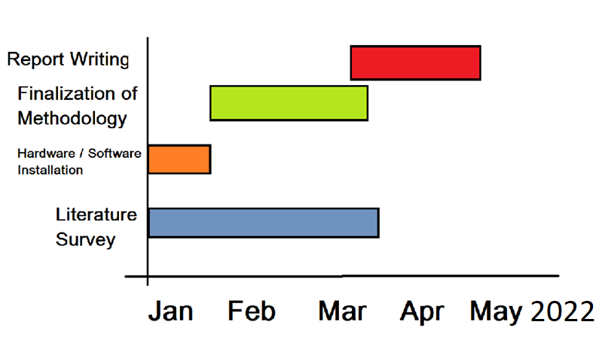
Project timeline
Sample Gantt chart format only. Need to be made as applicable by each project.

Slide 14
Q & A

Slide 15
Thank You

